Slide 1
Pedagogic Challenges in technology Intense, Quantitative Online Classes
American Association of Physics Teachers
Atlanta, February, 2017
By Ulrike Lahaise
Associate Professor of Physics/Astronomy
Georgia State University – Perimeter College/Online Campus
Notes:
Hi, my name is Ulrike Lahaise and I teach Astronomy Online lectures and labs at GSU - Perimeter College’s Online Campus. Today, I am talking about Pedagogic Challenges in Technology Intense, Quantitative Online Classes based on my experience with online Astronomy labs for non-science majors. The challenges my online students face are general ones, faced by all students new to science classes, such as lack of preparedness and negative attitudes about science, and specific ones based on the online mode. Those are the asynchronous online format, the additional layer of personal technology, and work/life/school issues preventing them from taking ftf classes.

Slide 2
Traditional Face-To-Face (FTF) labs structure
1 cred, 1 weekly 3 hr session, groups of up to 4, co-requisite to 3 cred lecture
Active investigation of lecture topics, scientific reasoning and basic math
Traditional lab session structure:
Short pre-lab exercise worked out prior
Brief pre-lab lecture by instructor
Group work on lab procedure, turned in individually at the end
GPC students at Alpharetta Campus, by Bill Roa

Slide 3
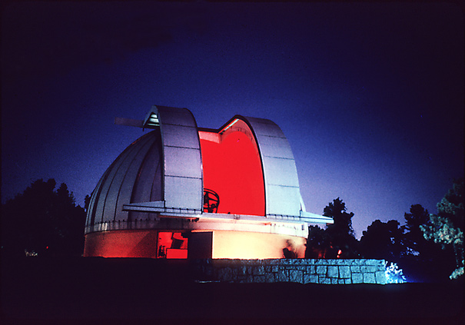
OL Lab Structure: Same credit, lab manual, # of labs
Same GSU-PC/external web sites
But: proprietary software/physical lab equipment in some FTF labs
Replaced by assignment labs: sci-fi movie review, observing session/planetarium etc.
Asynchronous interaction in iCollege*
Extensive support materials in Content tool
communication by Email/Discussion tools, live WebEx or phone call by request
Assessment tool to submit labs
*iCollege is our LMS = Learning Management System

Slide 4
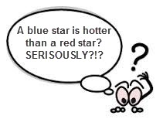
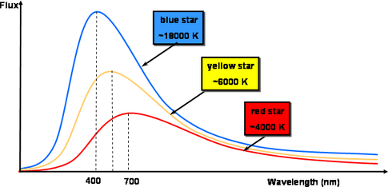
General challenges In Intro Science Labs: Non-Science Major STEM Culture Shock
Unfamiliarity with science
Scientific vocab = foreign language
Scientific thinking = counterintuitive
Familiar study tools (e.g. flashcards, memorization) not working
Lack of math preparation/confidence
additional time for clarification, practice
perceived need for “hand-holding”
Notes:
Now, there are general challenges that are common to ftf and ol environments but ol students have to deal with these alone, without immediate support from fellow students or instructor.

Slide 5
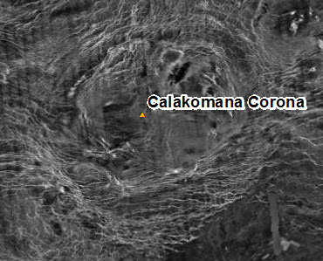
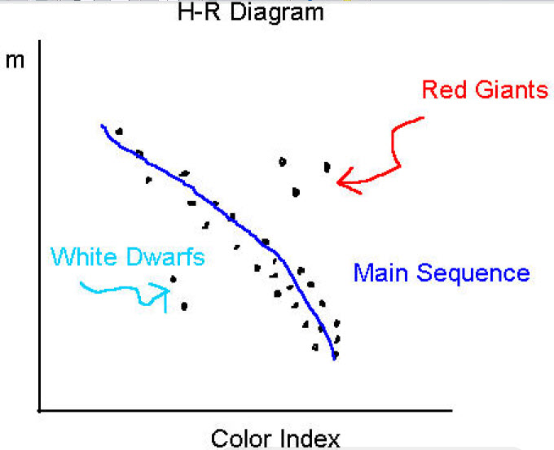
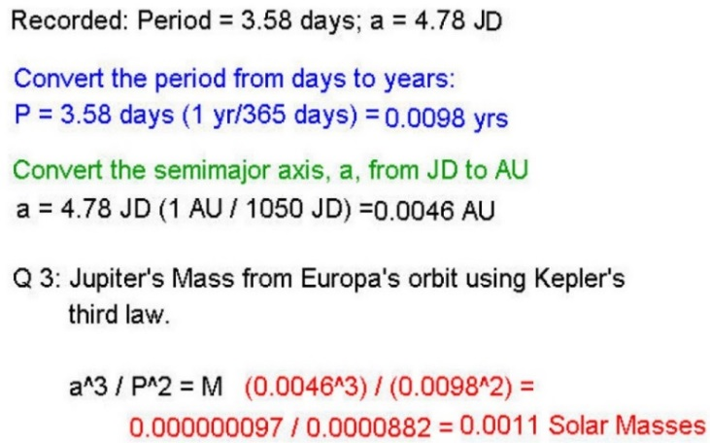
Unique Online Hurdle: ISOLATION in space and time
Images of strange objects and features
Data tables of strange properties
Graphs of strange quantities and physical laws
Complicated formulas, multi-step tasks
Numbers of with unfamiliar units

Slide 6
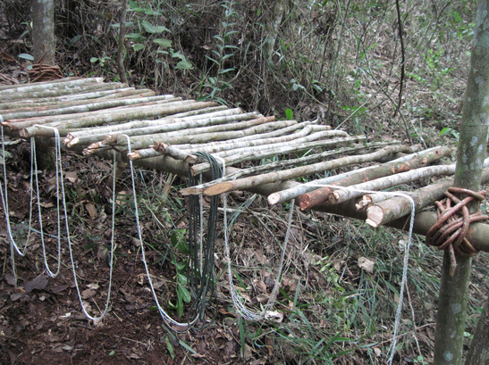
OL Technology Hurdles: problems running/downloading lab web sites and software
Technological environment has ALL possible permutations of
Electronic devices, computers, operating systems, browsers, firewalls, internet access
LMS (D2L) specific issues College/LMS tech support resolution
Course specific software Instructor resolution

Slide 7
OL Student Life Hurdles (Why They Can’t Take FTF Class): difficult, variable job & family demands
Life circumstances
Wildly varying work/family schedules
Overscheduled/taking too many classes
Unpredictable changes in job/family
Class put off until graduation (advisem.)
Students do classwork when
Physically & emotionally drained
In distracting environment
In random chunks of time/locations

Slide 8
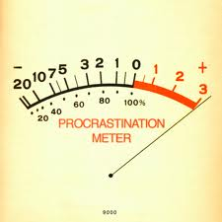
Compounding Effect: OL Mode, Tech Hurdles, Life Situations of Student Population
Need student initiative to reach out to teacher/peers in LMS
Large, initial cognitive load (learn course layout/navigation, trouble shoot technology ALONE)
>> FTF → >> 1 credit hour!
Unaware at registration (advisement!)
Feelings of isolation, inadequacy exhaustion, frustration
→ Procrastination, resentment
→ more likely to quit early on
What’s a teacher to do?
Notes:
Student quote: “Feels like I have already done a lab by just getting it to run!”

Slide 9
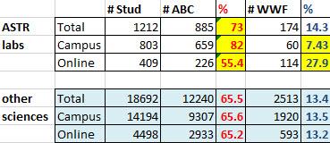
OL vs. FTF Pass/Fail/w’s: less passing, more W’s Online
FTF ASTR labs vs. science avg.
ABC% over 15% above
WWF% over 5% below
OL ASTR labs vs. science avg.
ABC% about 10% below
WWF% over 10% above
OL ASTR labs vs. FTF ASTR labs
ABC% over 25% below
WWF% about 20% above
Outliers (>= 5% off science average) shaded yellow
( Data from GPC’s ASTR lab sections: Fall 11, Spring 12, Fall 12)

Slide 10
OL vs. FTF Common Course Assessment: OL scores >= FTF scores
But: persisting OL students score >= FTF students!
Why do OL lab students drop out/fail at higher %?
How to get more OL lab students to persist?
→ Retention Question!
Note: not all sections participated

Slide 11
General Student Retention Hurdles (SEM Works¹): Instructor can only affect some: Engagement, Integration, Experience
Retention hurdles & who impacts them
Preparedness, motivation, adjustment (I) → high students, medium school
Engagement, social & acad. integr. (II) → high students and school
Experience (III) → medium students, high school
Life Circumstances (IV)
→ limited students, low school
Instructor Influence (II), (III) → teaching method, class environment
Notes:
by Dr. Jim Black, President & CEO of SEM (Strategic Enrollment Management) Works, student retention obstacles can be loosely grouped into general categories depending on how much of an impact the educational institution has on them.

Slide 12
Perimeter College’s student Population: Non-Traditional & High Risk of Attrition
1st year, 1st generation, learning support, minority, economically disadvantaged
Student success culture/strategies of utmost importance
Well designed communication plan
Flexible learning options for varied technology/life situations
Variety of support materials/instructional modes for different learning styles
Universal Design/accessibility principles
Meet students where they are
Coherent course design; targeted, consistent, well organized materials
“Safe to try on your own”, frequent peer interaction, individual teacher feedback
→ student independence (skills & confidence) will increase over time

Slide 13
Effectve Pedagogic Tool for FTF: Study Groups BUT Feasible for asynchronous OL classes?
Support: Social/Academic integration, engagement, course experience (II, III)
Study of 3 semesters of voluntary student availability data
only 20% available for study groups
Need 60+ students for several 4+ student groups to form consistently
Standard starting #: 25 – 35 per class
→ One OL campus resource section?
Study feasibility after GSU/GPC merger
GPC students at Clarkston Campus, by Bill Roa
Grand total students = 264
Available students = 52
Perc. Available = 19.7 %

Slide 14
method to Reach All Students Regularly: Individualized Performance Alerts Starting Early
In EACH class students receive regular alerts for scores < 70% on performance assessment criteria
first alert at 3 – 4 weeks, following alerts before midpoint (6 – 8 weeks) and 10 – 12 weeks
Alert email advises on tutoring resources and to contact instructor
Instructor chooses # alerts,composition of score, if counted in grade
My set-up: preparedness assign. + 2 current course %, not in grade
Does it help with retaining students? Look at data…

Slide 15
After Several Semesters of PASS : Lab passing percentage reaches that of lecture!
Lecture | ABC | DF | Total #
No PASS | 86 | 15 | 199
With PASS | 86 | 15 | 269
Lab | ABC | DF | Total #
No PASS | 74 | 25 | 285
With PASS | 85 | 14 | 202
% of passing grades increased!
% of failing grades decreased!
No change in pass/fail grade %

Slide 16
After Several Semesters of PASS : Lab: middle grades increased, fewer failing!
Lecture | A | BC | DF
No PASS | 42 | 43 | 15
With PASS | 34 | 51 | 15
Lab | A | BC | DF
No PASS | 53 | 21 | 25
With PASS | 53 | 32 | 14
B,C’s increased but A’s decreased, DF’s same. New set of quizzes?
A’s same, B,C’s increased, DF’s decreased! More students passed!

Slide 17
After Several Semesters of PASS : Assessment Scores improved for lecture, same for lab!
Lecture: switch to new quizzes same semester as start of PASS
Lower average letter grade!
More thinking, less cheating?
Surprisingly: same failing %!
Hypothesis: cheating opportunity doesn’t help DF – students pass
Lab: about same scores, but more students now pass!
Caveat 1: only my LMS data
Caveat 2: not able to track W’s
%Avg | Lecture | Lab
No PASS | 46.8 | 55.6
With PASS | 52 | 56.4
Notes:
New quizzes w/o publicly available answer key → No effect on failing percentage but increases letter grades of passing students!

Slide 18
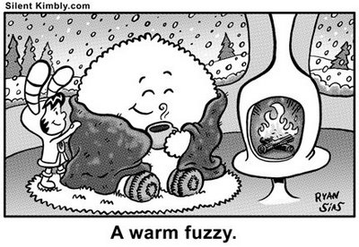
Boost Retention: Frequent practice, feedback & interactions
Advising BEFORE registration (required time/tech proficiency)
Performance alerts about every 4 weeks starting at week 4: Course Readiness, midpoint percentage, grade trend percentage
Require/model frequent log ins
Automatic custom note at 5 day non-login
Instructor checks all classes once a day min.
Lots peer-peer, instr.-stud. interaction
Lots “safe” low-stakes practice
Extensive support (videos, live tutors, pooled resource section)
Reduce non-content cognitive load
Virtual Desktop hosted by college

Slide 19
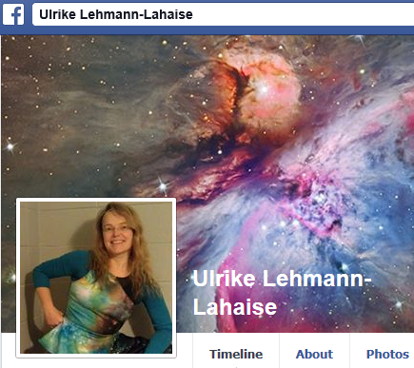
Questions? ulahaise@gsu.edu
References
1) “The Most Successful Retention Strategies”, Dr. Jim Black, President & CEO of SEM (Strategic Enrollment Management) Works, webinar sponsored by Innovative Educators, http://www.semworks.net
2) “Personalizing Online Learning: Tools & Strategies To Increase Engagement & Success”, B. Jean Mandernach, Grand Canyon University, webinar sponsored by Innovative Educators
3) “Three Questions to Reframe the Online Conversation”, Dr. Maryellen Weimer in The Teaching Professor Blog, Faculty Focus, March 11, 2015; http://www.facultyfocus.com/articles/teaching-professor-blog/three-questions-reframe-online-learning-conversation/#sthash.24UKvBIG.dpuf

